Slide 1


Slide 2

Under The Guidance of:
Dr. B.V Swathi
M. Charan(21R11A05C9)
S. Nashwitha(21R11A05E9)
T.A Sai Praneeth(21R11A05F1)

Slide 3

CONTENTS
Abstract
Objectives
Existing System
Drawbacks Of Existing System
Proposed System
Benefits Of Proposed System
Scope Of Project
System Architecture
Interface Design
Conclusion

Slide 4

ABSTRACT
Online shopping apps let consumers purchase products directly from sellers via web browsers or mobile apps. FitChk offers a seamless browsing experience with detailed product descriptions, a review and rating system to aid decision-making, and a user-friendly interface. Users can explore apparel categories like Men, Women, and Unisex for all their needs, from casual to formal wear.
With Web Development features and using HTML/CSS, JavaScript, PHP and MYSQL we are able to create “FITCHK” that has:
Easy Login/Sign-Up Process.
Rating and Review Section.
Multiple Payment Options.
Diverse range of products.
Choose from categories such as Men, Women and Unisex apparels.
Wishlist/Cart.

Slide 5

OBJECTIVES
Implement a user-friendly interface using HTML and CSS.
Allow users to add items to the shopping cart.
Provide a secure and efficient checkout process.
Integrate PHP for server-side processing and data management.
Utilize JavaScript for dynamic interactions and enhanced user experience.
Display and manage apparel products effectively.
MYSQL is used for database creation and effective management of the products

Slide 6

Existing system
E-commerce websites are essential for modern retail, enabling consumers to browse and purchase products online. They typically feature product catalogs, search functionality, shopping carts, and secure payment gateways.
Built with HTML, CSS, JavaScript, and server-side technologies like PHP or Python, these platforms combine structure, style, interactivity, and data processing. Modern systems often include User Reviews, Wishlist, personalized recommendations, and responsive design, and they integrate with third-party services for Payment, Shipping, and customer support.

Slide 7

Drawbacks of Existing System:
Performance Issues: High traffic or poorly optimized code can lead to slow loading times and decreased user satisfaction.
Security Concerns: Vulnerabilities in payment systems or data handling can expose sensitive customer information to potential breaches.
Complexity in Management: Managing inventory, processing orders, and handling customer queries can be challenging, particularly for smaller businesses.
User Experience Problems: Inconsistent design, difficult navigation, or lack of mobile optimization can lead to a frustrating shopping experience.
High Competition: With numerous e-commerce platforms available, standing out and attracting customers can be difficult without effective marketing and unique value proposition.

Slide 8

PROPOSED SYSTEM
FitChk is designed to enhance your online shopping experience with a focus on simplicity and efficiency. The website features an intuitive layout, making it easy for users to navigate through a variety of apparel products. Using a blend of HTML, CSS, JavaScript, PHP and MYSQL, FitChk ensures that your shopping journey is smooth and enjoyable.
The core functionality of FitChk includes a powerful UI that helps users experience a seamless shopping journey and find their desired choice of apparel. Users can also browse clothing with the Categories/Brands section where they can choose based on categories such as Men, Women or Unisex and from the various Brands available on the website.
Once they’ve found their desired items, they can easily add them to their shopping cart. The checkout process is straightforward and secure, allowing for a hassle-free transaction. FitChk’s design is not only visually appealing but also functional, with a user-friendly interface that aims to fulfil the shopping needs of the users

Slide 9

Benefits of Proposed System:
Curated Apparel Collection: FitChk offers a carefully selected range of apparel, ensuring that customers have access to trendy and high-quality products.
Support for Local Businesses: FitChk collaborates with local retailers, giving them a platform to reach a broader audience and helping to boost the local economy.
User-Friendly Interface: The website's clean and intuitive design makes it easy for customers to navigate, search for products, and complete purchases.
Enhanced Classification: With division of products, customers can quickly find exactly what they are looking for, whether by category or brand.
Efficient Checkout Process: FitChk streamlines the checkout process, making it quick and easy for customers to complete their purchases with minimal steps.

Slide 10

SCOPE OF THE PROJECT
The scope of the FitChk project encompasses a comprehensive e-commerce platform designed to offer a wide array of options and brands, catering to diverse customer preferences in apparel. The project aims to provide an extensive catalog of clothing items from multiple brands, ensuring that users have access to the latest trends and high-quality products.
The platform will feature advanced search and filtering options to help customers easily navigate through various categories and find exactly what they need. A significant aspect of FitChk is its commitment to security.
It includes robust login and authentication mechanisms to protect user accounts and sensitive information. By prioritizing a broad selection of products and a secure shopping environment, FitChk strives to enhance the overall user experience and build trust with its customers.

Slide 11
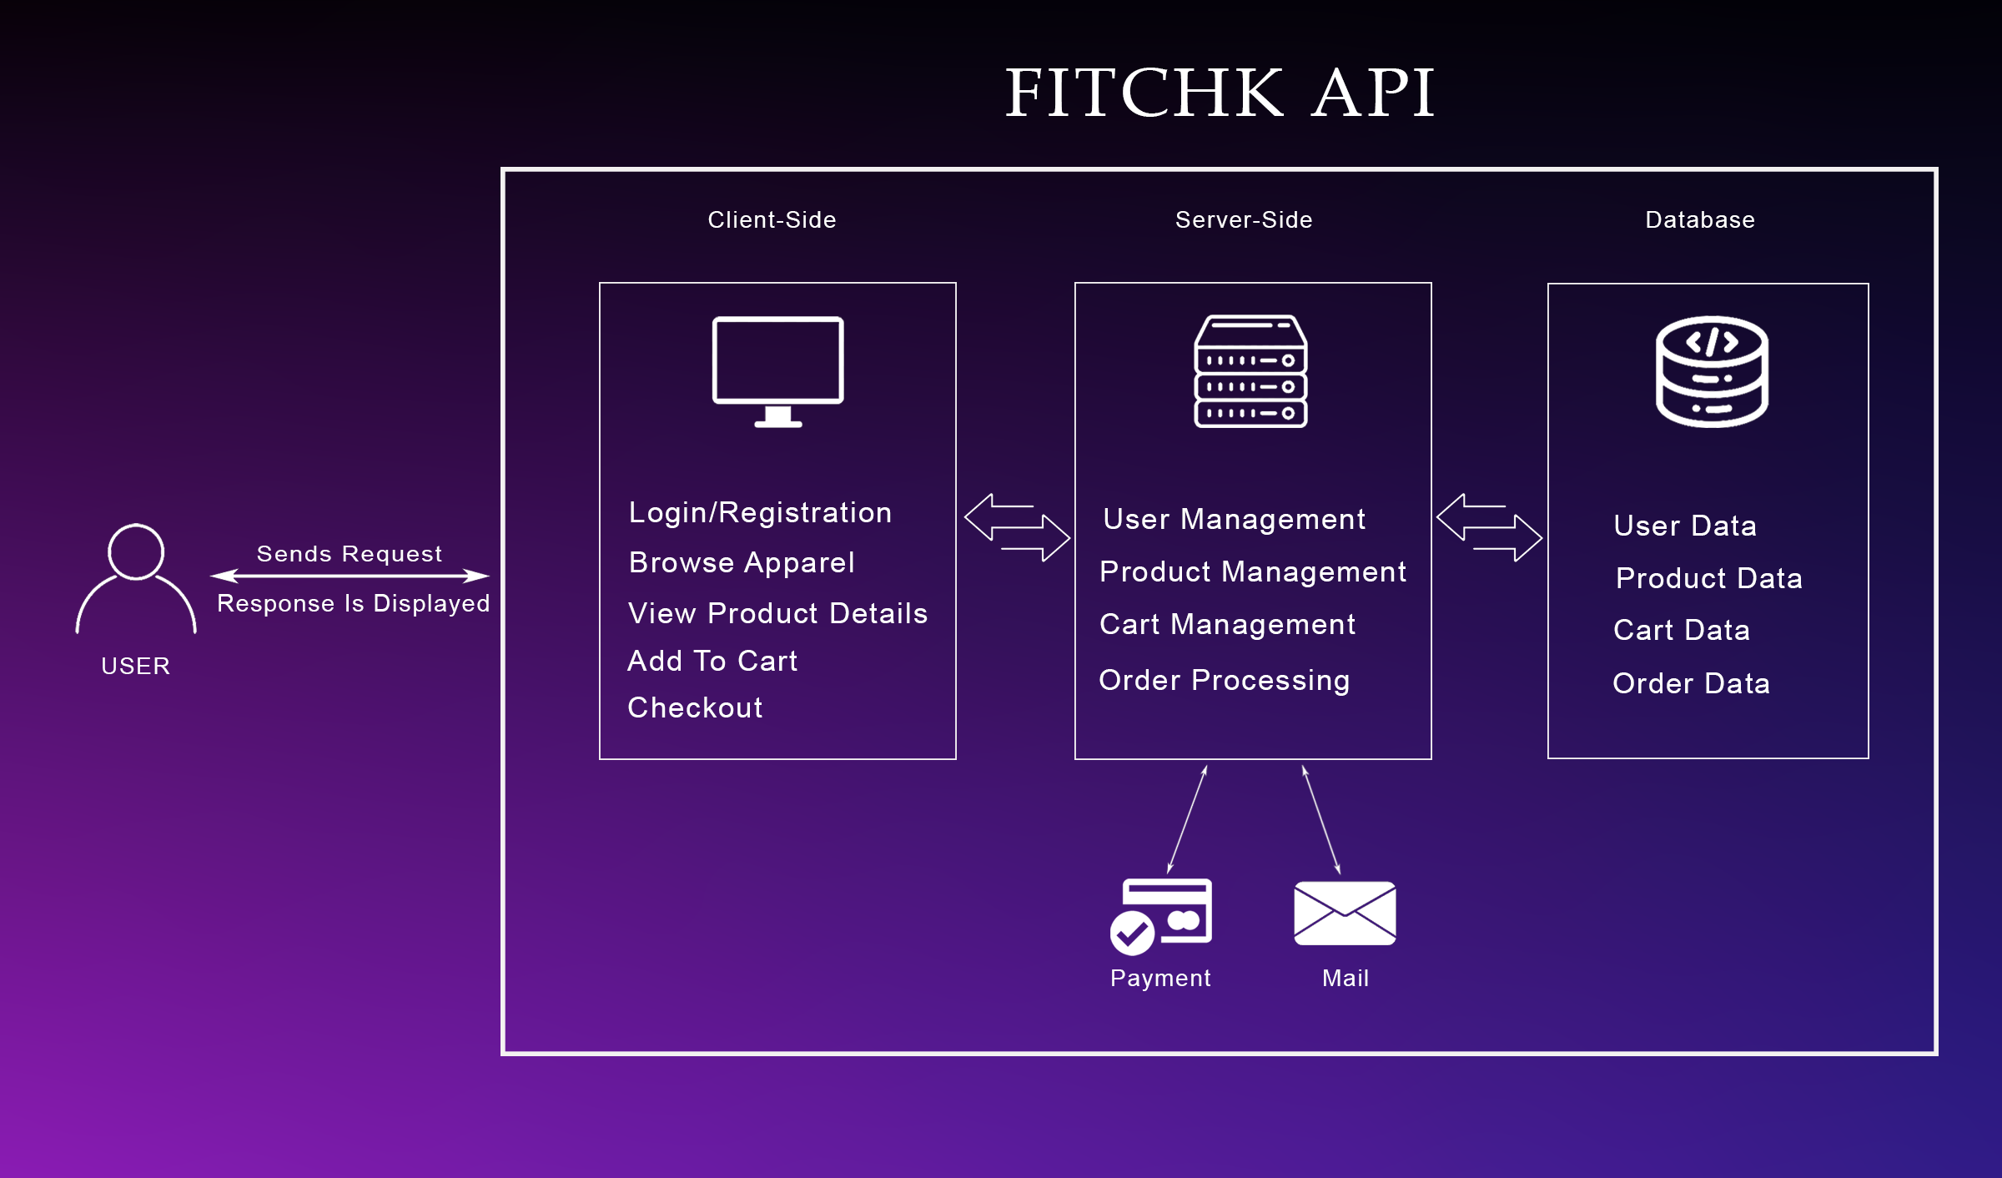
SYSTEM ARCHITECTURE

Slide 12

INTERFACE DESIGN

Slide 13
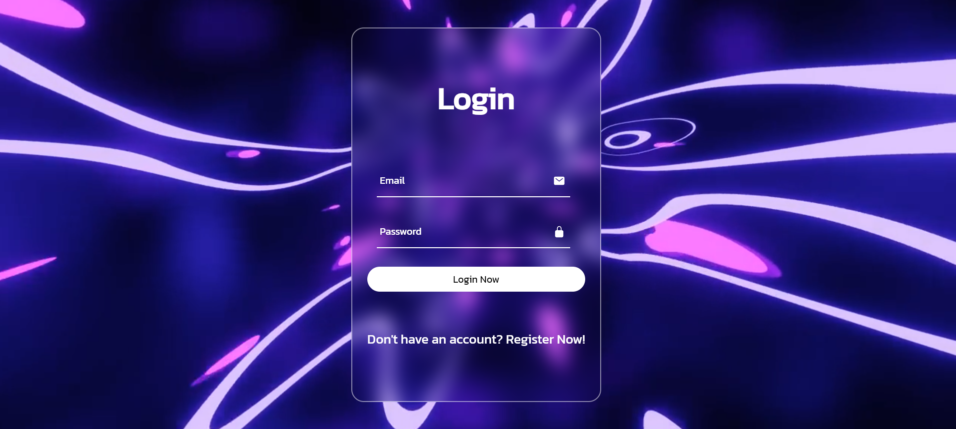

Slide 14
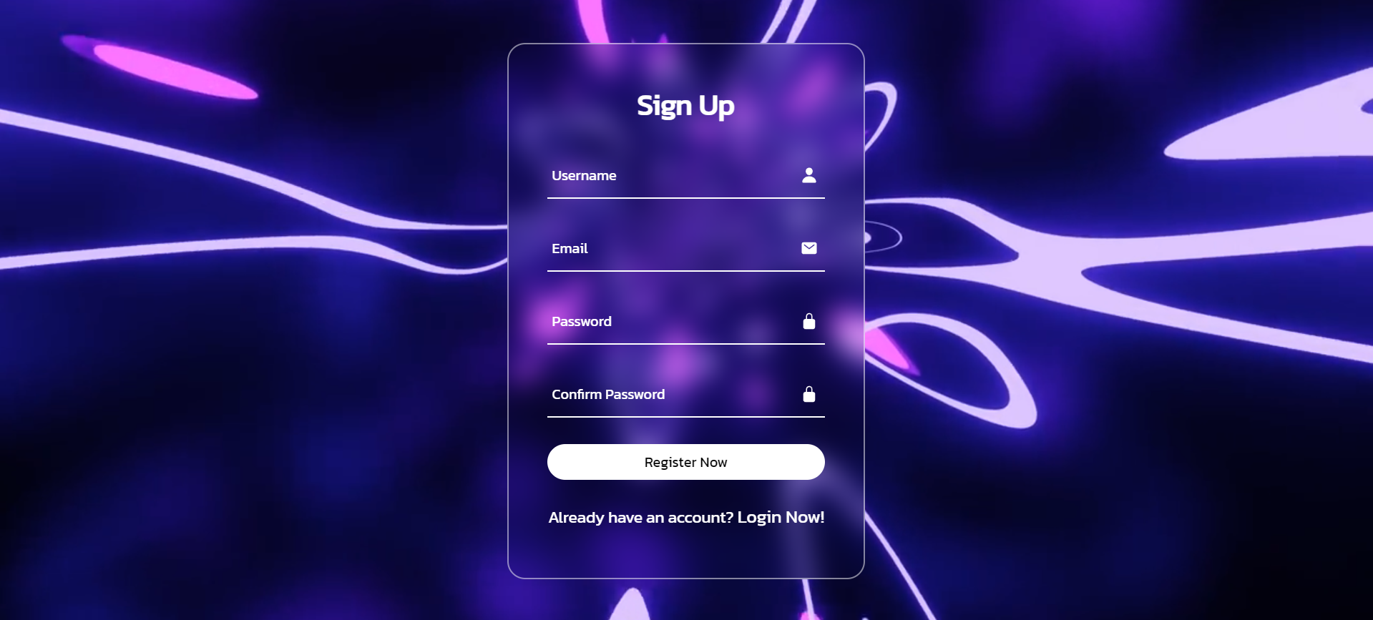

Slide 15
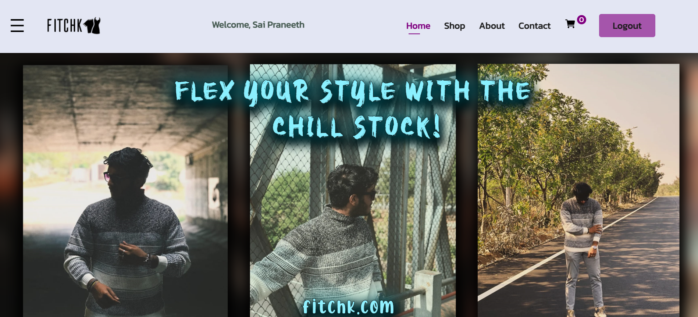

Slide 16
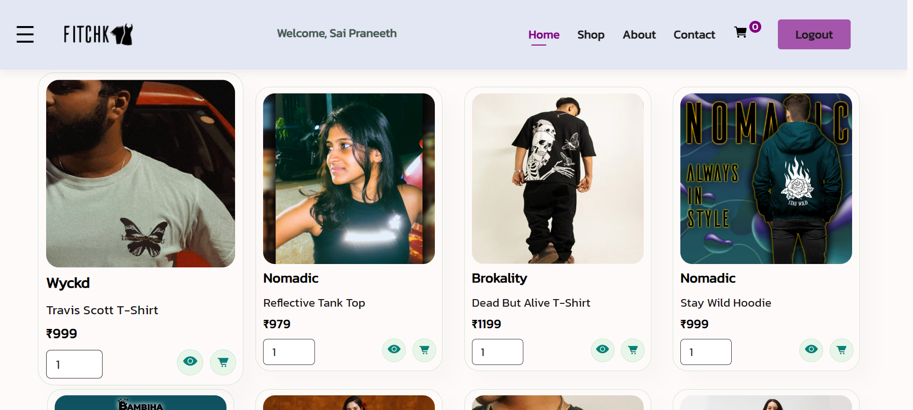

Slide 17
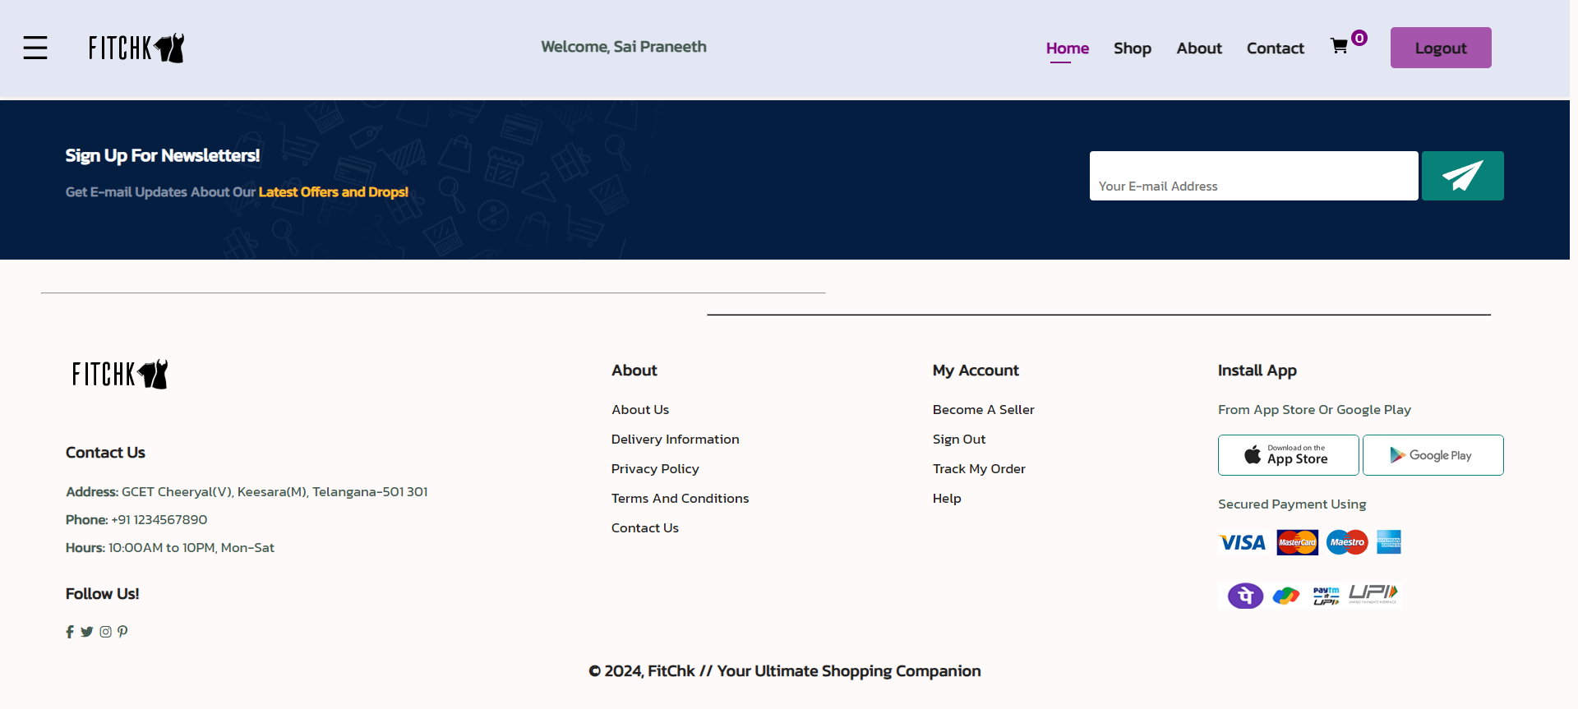

Slide 18
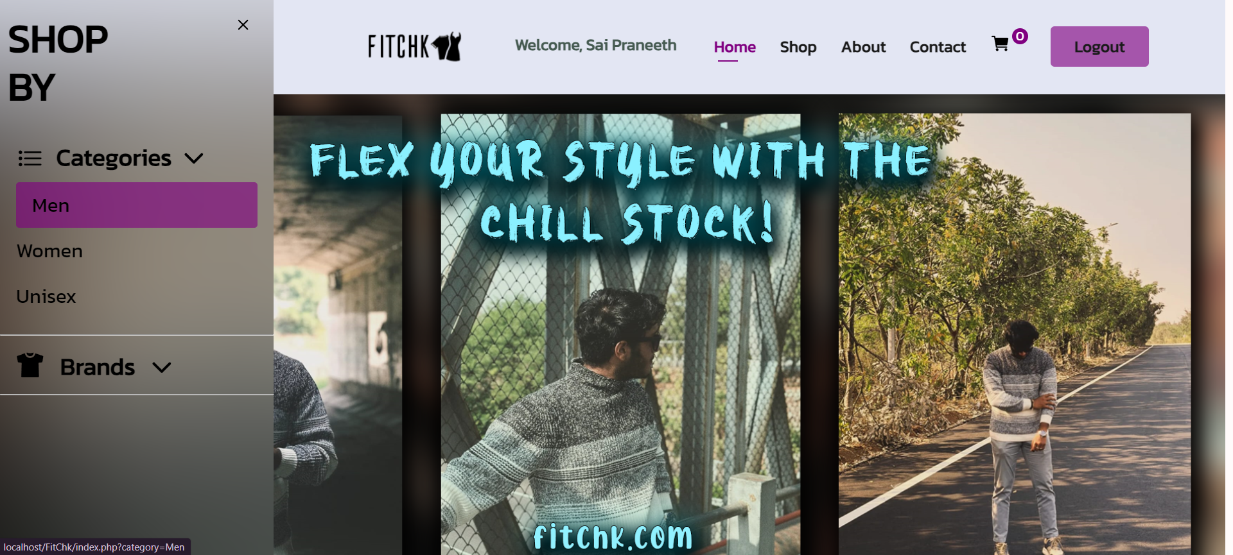

Slide 19
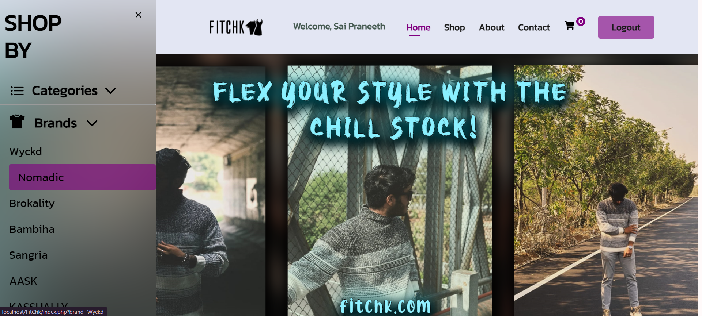

Slide 20
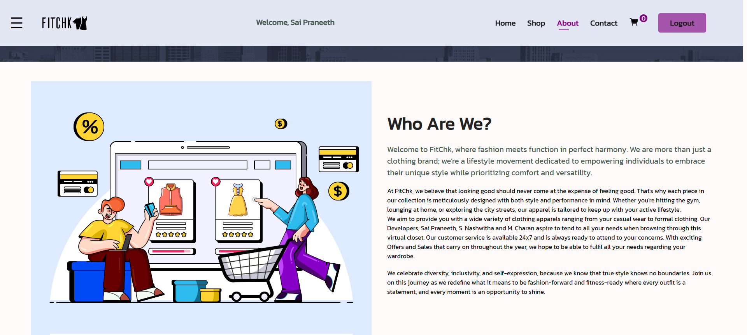

Slide 21
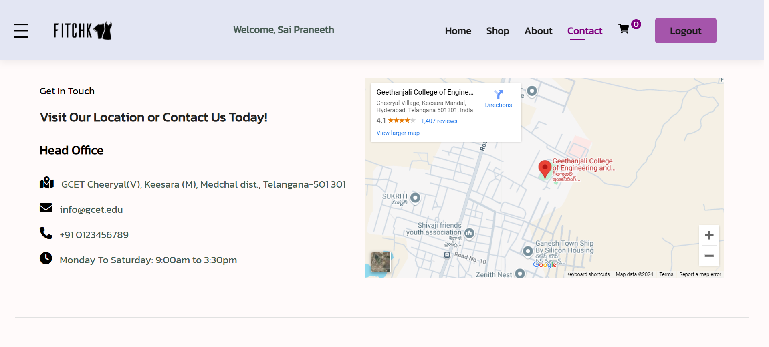

Slide 22
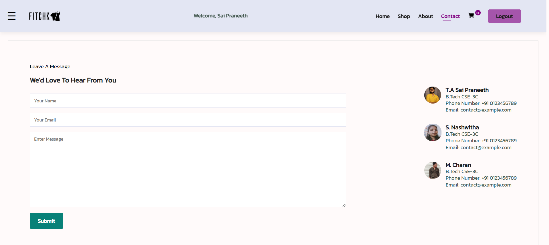

Slide 23
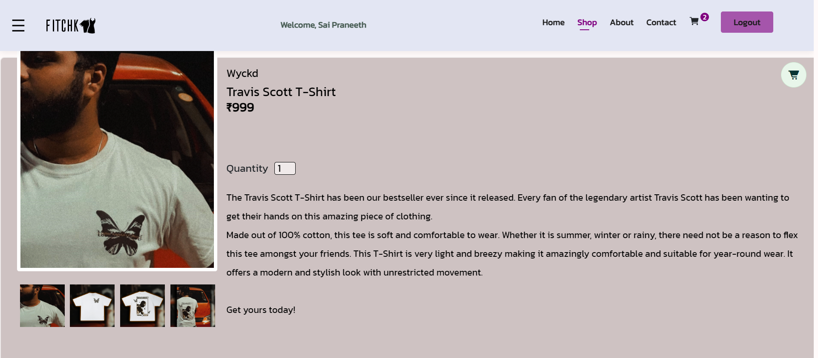

Slide 24
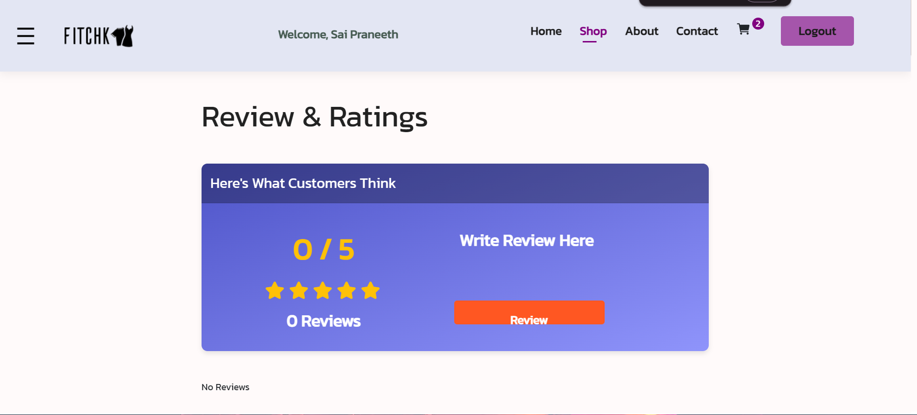

Slide 25
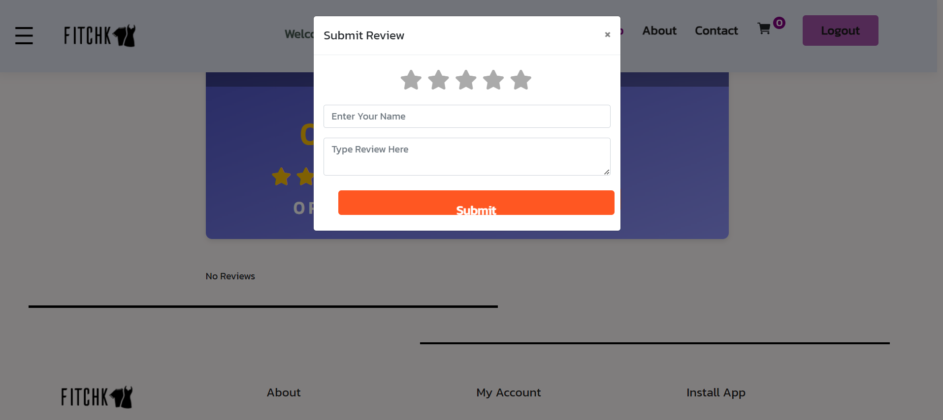

Slide 26
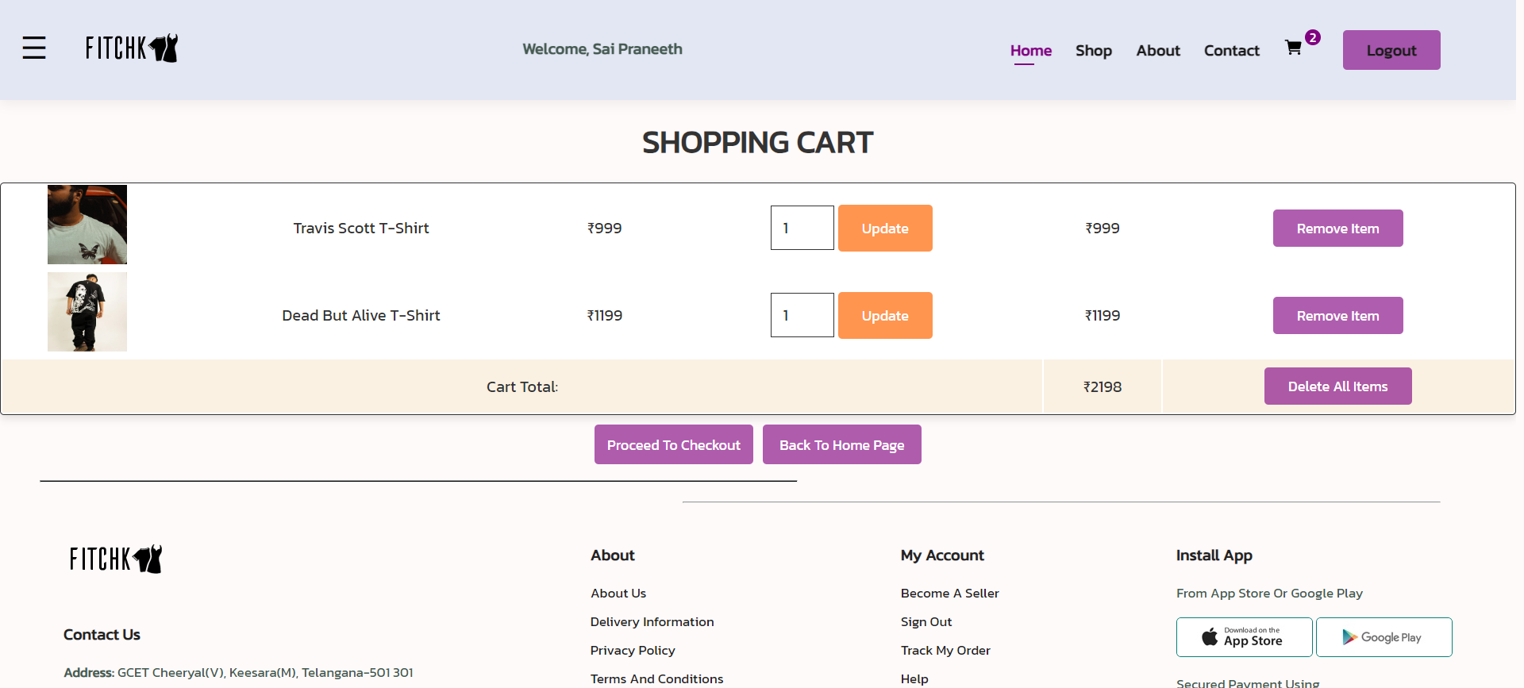

Slide 27
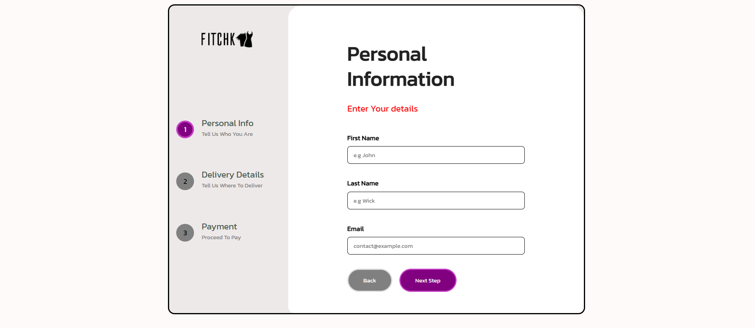

Slide 28
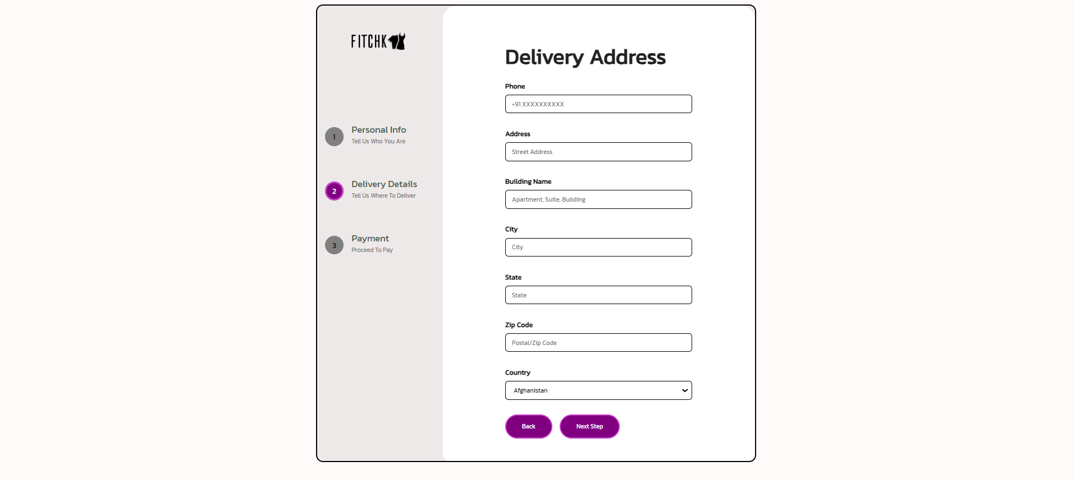

Slide 29
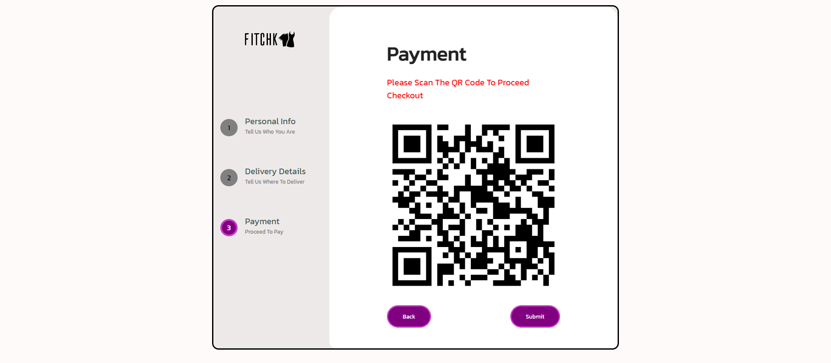

Slide 30
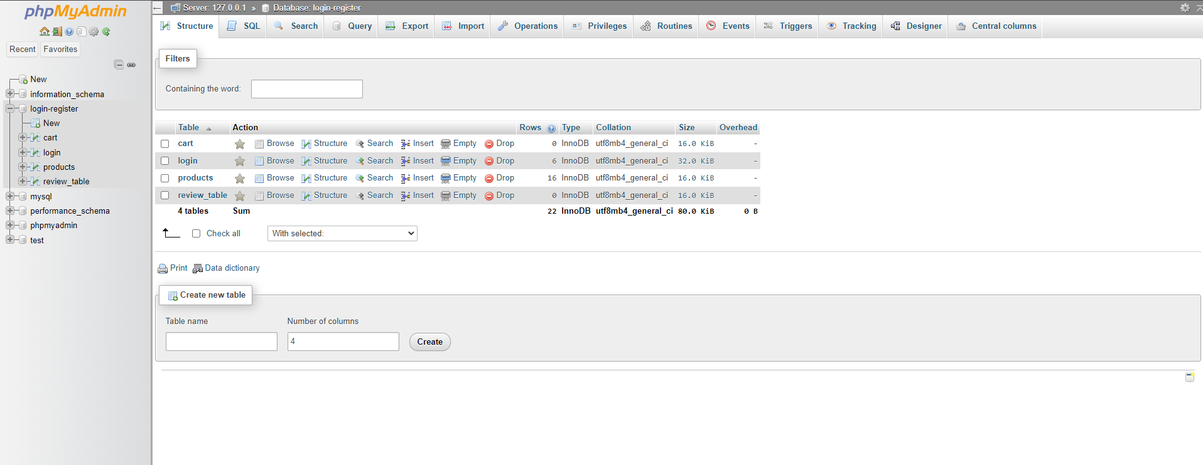

Slide 31

CONCLUSION
FitChk is a modern e-commerce platform that integrates key features like secure user registration, product browsing, cart management, and a streamlined checkout process. It supports local businesses and offers a wide range of apparel, positioning itself as a scalable solution in the competitive online retail market.
The architecture of FitChk is designed to ensure a seamless shopping experience across multiple devices. With its robust backend and carefully crafted user interface, the platform meets the needs of today’s consumers while laying the groundwork for future enhancements, such as personalized recommendations and expanded product categories.
Overall, FitChk not only fulfills its core mission of delivering a reliable and enjoyable online shopping experience but also demonstrates a commitment to supporting local businesses and adapting to the evolving demands of the e-commerce landscape.

Slide 32


